Slide 1
PAC-MAN
Azyah Martin, Kassandra Tchemi, Q’Lae Mann, Tavianne Maultsby, and Zora Johnson

Slide 2
Objective
Create & Develop Game
Utilize Binary Representation
Have Fun!
Notes:
our objective was to create and develop A player playing a 2D video game needs to be entertaining and engaging while it is also easy and addictive. Also, we wanted it to embed some aspect of the binary number system, binary arithmetic, or binary representation.
We also wanted to focus on using binary representation. A binary code represents text, computer processor instructions, or any other data using a two-symbol system. The binary code assigns a pattern of binary digits, also known as bits, to each character, and instruction. Binary numbers are important because using them instead of the decimal system simplifies the design of computers and related technologies. Also by using what we already know , and then researching how to actually use it within the game, We also ask the questions what do we know, what do we need to know, and what will we need to do to find it about binary.
Lastly, we want anyone who plays our game to have a fun experience doing something differ

Slide 3



Ideation & Brainstorming
How Might We?
Mural Board
Prioritization
Notes:
Defined Problem Statement- HMW statement – What game? math game?
Mural Board- We used the mural board – decided to make pacman
Prioritzation- We had to prioratize certain aspects of the game and be time curtious when developing our game.
For our ideation and brainstorming we had multiple sources to use. We used Monday.com to log everything that we did throughout the project, so we can keep a time stamp of everything that was being done, and who it was being done by. Also, we to find the main objective of our project so there would be a clear picture of what we were aiming for. As a group, we met on a weekly basis in order to stay on top of the project, and we worked with each other on different platforms.
Mention HMW question
Q’LAE

Slide 4

Build Phase
Greenfoot
Research
Testing / Experimentation
Notes:
For the creation of our game, we utilized the application Greenfoot which allowed us to collaborate through a github repository. In order to complete the aspects of the game necessary, we needed to research the ways in which objects of our classes could interact with one another to produce a fully functioning game that satisfied our previous objective. As the game was built, each member of the group made changes to things like the maze, the consumable items, the character and the enemies or obstacles for the user to encounter. This required us to go through and test for bugs, or errors we didn’t want to appear in the final game. The amount of testing done meant, tedious experiments in the construction of the code and minor changes being made until the game was playable the way we intended. Most of these procedures used scrum methodology and implementation to maximize our time and efficiency as a group.
TAVIANNE

Slide 5
SCRUM Roles & Methodology
SCRUM roles:
Kassandra T -- SCRUM Master
Q'Lae M -- Product Owner
Notes:
What is scrum framework?-
What is product backlog - a prioritized list of work for the development team that is derived from the roadmap and its requirements.
Sprint planning- The purpose of sprint planning is to define what can be delivered in the sprint and how that work will be achieved
Explain what Kassandra did as a scrum master – set meetings, kept everyone on track,
Explain what Q did as a product owner
Had to prioratize Monday.com so that we could keep track of what was, has, and is being done on the project.
Q’LAE

Slide 6
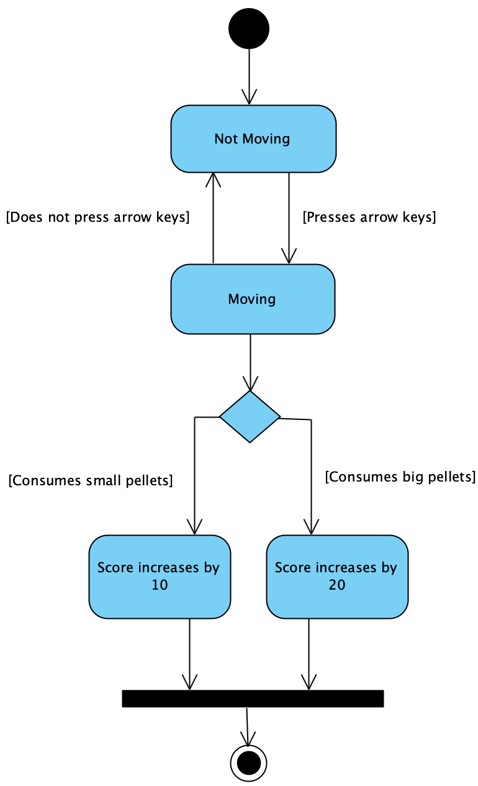
Activity Diagram
Notes:
Activity diagram demonstrating a pac-man’s path to collecting pellets

Slide 7
PAC-MAN Live!
Notes:
Kassandra and Azyah
(Walk the audience through the prototype and provide a demonstration of the prototype in action. Where possible, allow the audience to participate in the demonstration of the prototype)

Slide 8
Obstacles
Accountability
Technical Issues
Unfamiliar Application
Implementing Binary
Notes:
During our project we faced several obstacles.
Accountability – holding ourselves accountable. Missing meetings, seeking help, not completing tasks… overall, the lack of accountability delays the progress and successfulness of completion of our game
Also, we faced some technical issues where some members in our group had trouble with being able to access the project, so they weren’t able to view work tht was being added or add their own portion of code or make changes
As well as being unfamiliar with the applications used for this project. At the time that this project was introduced we didn’t know too much about green foot, and therefore delayed our process with getting our game implemented. GitHub repo.. Needed to be learned quick bc.. Being able to collaborate wouldn’t have been possible w/o the vital tool of our repo. We’ve used it for homework assignments but never in a collaborative fashion.
Lastly, as far as binary… We weren’t exactly sure where and how to use at first. And we were stuck at that point for majority of the project. Although, we knew what in our game we wanted to represent the binary with
KASSANDRA

Slide 9
Conclusion
Pac-Man – fun, easy, and addictive!
Binary Implementation
Working in a Team
Challenging
Notes:
We decided on Pac-Man because we knew we could alter it and still make it fun, easy, and addictive
While still implement binary into it in some way
Working in a team for this project was a challenge at times but it allowed us to bounce many ideas off of each other and help each other
There were times when creating this game was challenging but that just made it more fun for us because we were able to learn new things
We just overall hope that this game is enjoyable

Slide 10
Questions? Comments?
Notes:
{Time for audience to ask any questions or address anything specific in the powerpoint}

